Slide 1

INTERNET OF THINGS AND BIG DATA ANALYTICS
2022_07

Slide 2


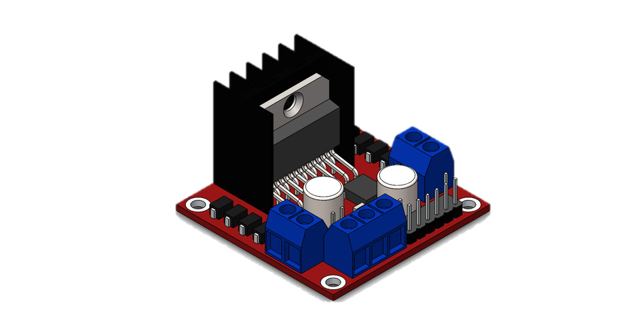
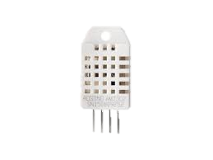
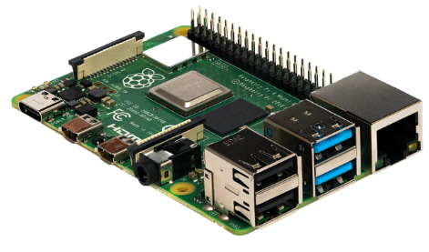


System Overview Diagram
Dashboard
Stepper Motor
DHTT11
L298 Motor controller
Subscribe
Publish
RaspberryPi
HiveMQ

Slide 3









Past Data Visualization
Future temperature prediction
Current temperature
Dashboard
MQTT
Node-red
Actuator
Temperature Sensor

Slide 4
Sensor Readings
Temperature senor will be activated, and the system will start to read the ambient room temperature.
According to the room temperature the gauge will indicate 3 temperature levels.
If room temperature:
< 20 deg Celsius:
Cool
20 deg Celsius = < && = < 30 deg Celsius:
Warm
> 30 deg Celsius
Hot
When a keyboard interruption is detected, the program will end.

Slide 5
Remote Access
Temperature data from the sensor is published to node-red via HiveMQ broker.
For remote access, published temperature details are subscribed through MQTT.
Subscribed data is visualized using a Node-red dashboard.
Current temperature is visualized using gauge node.
A line chart is used to visualize the current temperature variation throughout the time

Slide 6
Past and Future Temperature Visualization
Historical temperature data was cleaned and imported to node-red dashboard.
Function is written to generate visualization related to the past data using node JS.
A line chart visualize the past temperature data.
The dataset was cleaned to filter the average temperature and city Colombo Sri Lanka.
The cleaned GlobalLandTemperaturesByCity dataset is used to forecast future temperature data for the next 12 months(2014) using the ARIMA model.
A function was written using JS to generate a line chart using a graph node by the data which was imported to the node-red dashboard using a csv node.
The forecasted future temperature is visualized in a line graph.

Slide 7
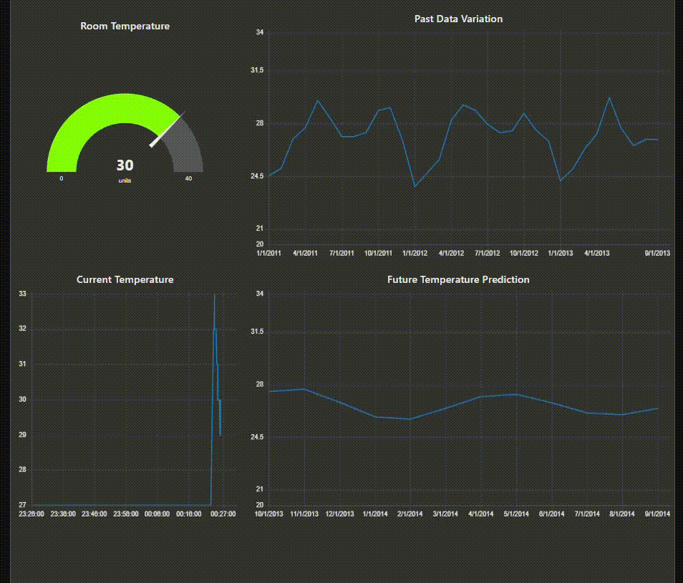
Node-red Dashboard
Notes:
Please play full screen to view the node-red dashboard variations.

Slide 8
Future Implementation
To enhance the accuracy of the temperature and to get wider range of temperature implement a hardware system using DHT22 temperature and humidity sensor.
Use digital actuator to show temperature in digits.
Build interactive visualizations in node-red dashboards which will show data only for the selected date range.
Visualize real time temperature and humidity fluctuation to a mobile application.

Slide 9
MEET THE TEAM
Fernando W.N.D.
Hillary J.R.
Vithyashagar S.T.
Kumarage L.V.A.

Slide 10
THANK YOU

